Slide 1

Object Oriented Programming (OOP)
Lecturer
Rokas Slaboševičius
Data

Slide 2
Today you will learn
Object Oriented Programming (OOP)
Classes
Simple Composition
01
04
Classes "Properties"
Complex Composition
02
05
Class Constructors
03

Slide 3


Classes
Object Oriented Programming (OOP)
Object-Oriented Programming (OOP) is a programming paradigm that uses objects and their interactions in the architecture of computer programs.
The basic idea of OOP is to model real-world objects in program code.
A class is a template for an object that defines its properties and actions.
An object is a specific instance of this template, with its own state and ability to perform actions.
For example, if the class is "Car", then the objects would be specific machines with unique parameters and action options.

Slide 4

4 Pillars of PPE
Object Oriented Programming (OOP)
Inheritance: inheritance allows OOP to create a hierarchy in which one class can inherit properties and actions from another class
Abstraction: abstraction in OOP allows you to hide the complexity of the object implementation and offer a simplified interface that can be used.
Polymorphism: Polymorphism in OOP allows a single object to be used in different situations. It allows the behaviour of objects to be changed according to the context.
Encapsulation: encapsulation allows the OOP to encapsulate data and actions in a single object. This means that the data and the actions that relate to it are hidden from the outside world.

Slide 5
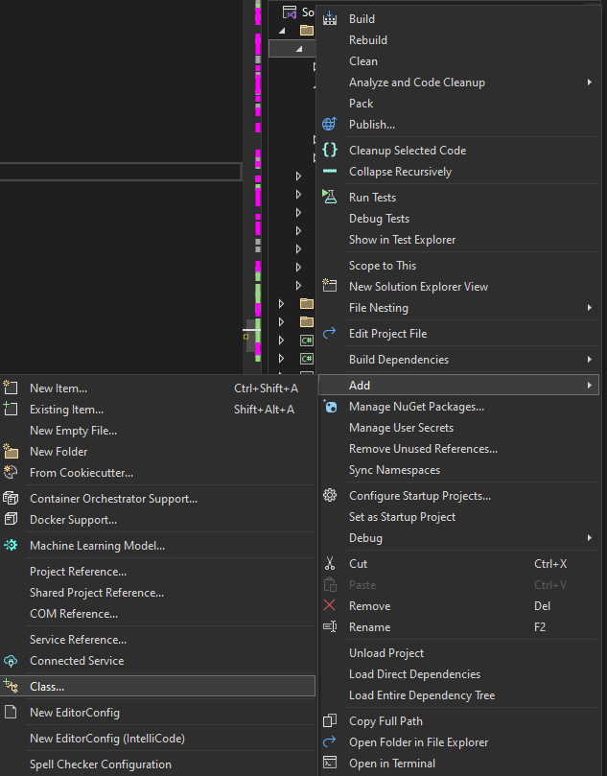
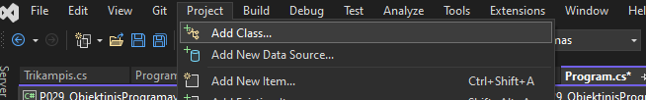


Creating a class
Object Oriented Programming (OOP)
First: We create a new class (In the example, we will create it in a new "file"). You can choose to add a new class "file" either by right-clicking on the project name or by selecting "Project" from the menu bar
Second: We write the name of the class and see how our class is generated (public class Car)
Third: We create an instance of the class as shown in the Main method example

Slide 6
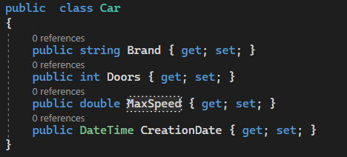
Classes "Properties"
Object Oriented Programming (OOP)
A class property (Property) is needed to ensure that the objects created by our class have a state or data that belongs only to that instance of the class (Instance)
To define a Property we need to hover the mouse over our class, write "prop" and click the "tab" button 2 times.

Slide 7
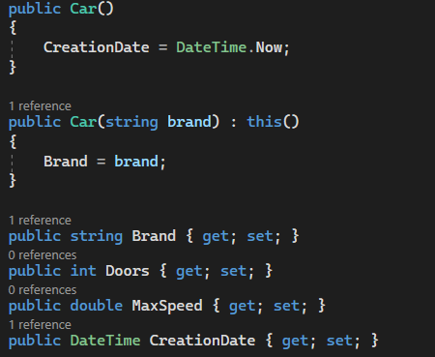
Class Constructors
Object Oriented Programming (OOP)
Constructors also support "constructor chaining". This allows us to repurpose constructors that have already been created using the word "this".
In this context, we are saying that when we use the Car(string brand) constructor, we also want to call the code in the empty Car() constructor.
To do this, we use ": this()". The "this" in this place tells the program that we are talking about an object that has been created/is being created.

Slide 8
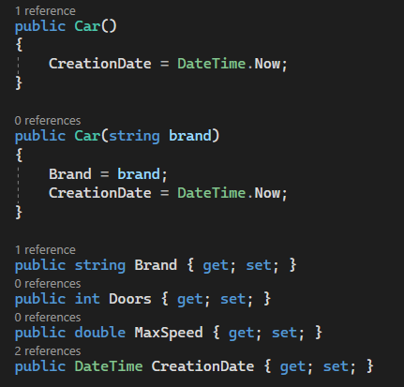

Class Constructors
Object Oriented Programming (OOP)
When we initialize a class object we use the class constructor
The constructors help us to set the initial values of the newly created object, e.g.: creation date and time
The constructors also support "overload". This allows us to have multiple constructors, the most important thing is that the "signature" part of the constructor is different e.g. we can have an empty constructor, but also if we know information about the object give it a name.

Slide 9

Object Oriented Programming (OOP)
Task 1
Create a class "Person" with the properties name and age. Write a constructor that initializes these properties. Create an object of the class and print the name and age of the person.
Expand the Person class from the previous exercise by adding the height property. Add another constructor that accepts height to initialise the height property. Create an object of the class and print the name, age and height of the person.
Create a class called "School" with properties name and city. Write a constructor that initializes these properties. Create an object of the class and print the name and city of the school.
Expand the School class from the previous exercise by adding the Number of students property. Update the constructor to initialise the number of students property. Create a class object and print the name of the school, the city and the number of students.

Slide 10
Object Oriented Programming (OOP)
Task 2
Create a class "Book" with properties title, author and year. Write a constructor that initializes these properties. Create an object of the class and print the title, author and year of the book.
Expand the Book class from the previous exercise by adding the country of edition property. Update the constructor to initialise the permission country property. Create an object of the class and print the title, author, year and country of publication.
Extend the program by creating a method that accepts a list of books and the name of the author you are looking for. The method should return a new list of books that were written by the passed author.
Create a "Store" class. This class should store the year of opening, a list of product names and the name. Create several "Store" objects and print all products for all stores in the following format "{Name} {Date} - {ProductName}"

Slide 11
Object Oriented Programming (OOP)
Task 3
Create and describe the Dog, Cat and Hamster classes. Each class should have 2 constructors - 1. Which accepts nothing 2. Which accepts all the "Properties" names given to your class as arguments. Create their objects and create a new method that accepts all newly created classes and returns their names in a list.
Extend the program by creating a method that accepts lists of newly created classes(3 Lists), but returns a dictionary filled with the number of each kind of animal e.g. Dog 8 Cat 7 Hamster 7
Create the Triangle, Square and Circle classes and describe them with the necessary properties and constructors. Extend the program with method(s) that can accept the created shape and return its area. Do the same with the perimeter.

Slide 12
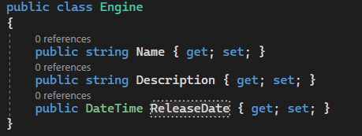
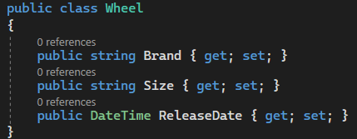
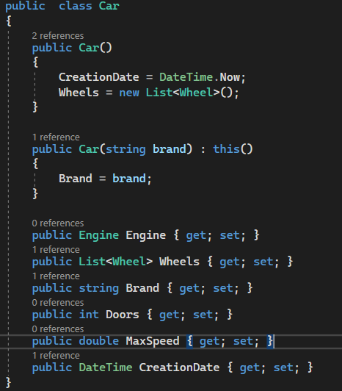
Simple Composition
Object Oriented Programming (OOP)
In object-oriented programming, it is very important that your classes correspond to reality. In reality, we know that a machine is made of complex types (other classes) like wheels, engine.
Each of these classes can have its own "Properties". Whether it is year of manufacture, publisher, size, quality, etc.
This process is called composition, and to implement it we just need to write a new "Property" in an existing class, whose data type is another class or a list of another class.

Slide 13
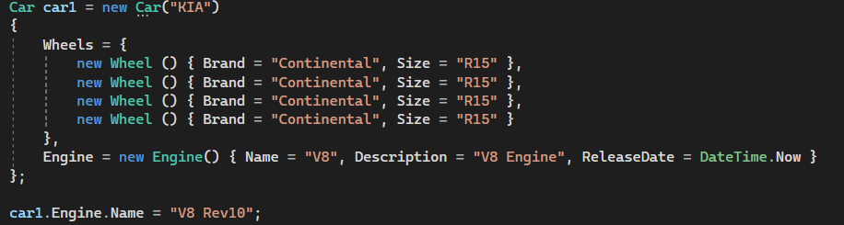
Simple Composition
Object Oriented Programming (OOP)
To update the information in our composite classes, we need to call our parent class object and use it to update the information in each composite object individually as shown in the example.

Slide 14
Object Oriented Programming (OOP)
Task 4
Create a class "Car" that has a compositional relationship with an object of class "Engine". The "Car" class should have a method that allows you to start the engine. "The Engine class should have a Property that returns information about the state of the engine (on/off). Create a method that accepts a Car object and outputs to the screen whether the engine of this machine is on.
Create a class "Person" that has a compositional relationship with an object of class "Address". The "Person" class should have the properties name and age, while the "Address" class should have the properties city and street. Create an object from the "Person" class and print its information, including the address.
Create a class Bank that has a compositional relationship with the objects of the class Account. You should create a method that accepts a Bank object and opens a new account. The "Account" class should have properties owner and balance. Create objects from the "Account" class and perform operations like opening accounts and updating the balance.

Slide 15
Object Oriented Programming (OOP)
Task 5
Create and describe the classes needed to create an e-shop. Think about what your shop sells. Who are its users. Try to create a detailed functionality of the e-shop from the buyer's side. When you switch on the application, you can look at the products, filter them minimally by category, add them to the shopping cart and go shopping.

Slide 16
Object Oriented Programming (OOP)
https://learn.microsoft.com/en-us/dotnet/csharp/fundamentals/tutorials/oop
Useful information

